Slide 1

307304 Data Mining
Association Rules Mining & Apriori Algorithm
2024-2

Slide 2
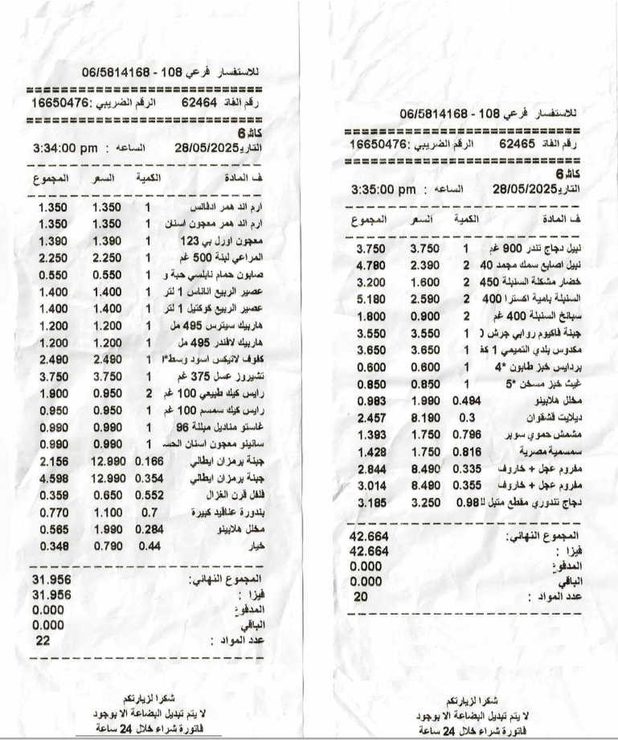
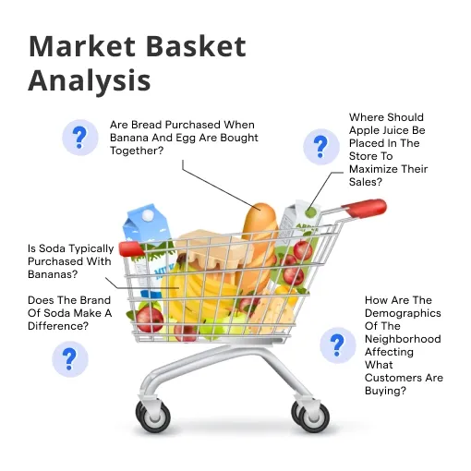
Introduction to Association Rule Mining
What Is It? Association Rule Mining is a data mining technique used to discover interesting relationships or patterns between variables in large datasets, typically in the form:
If A, then B
e.g.
If {Milk}, then {Bread})

Slide 3
Real Life Use Cases
Retail:
Items ↔ Items: "Customers who buy Milk also buy Bread“
Suggested Actions:
Place Milk close to Bread (in-store layout)
Recommend Bread when Milk is added to cart (cross-sell)
Offer Milk + Bread at a discounted price (bundle offer)
Expected Results: Increase in Bread sales.
E-commerce Recommendation:
Items ↔ Items: “Customers who buy iPhone also buy Phone Case”
Action: Auto-suggest phone cases during iPhone checkout
Expected Results: Many iPhone buyers also purchase cases
Healthcare:
Symptoms ↔ Diseases: "Patients with fever and headache often have flu“
Used for: Diagnosis support
Action: Flag patient records or prompt flu tests when both symptoms are present
Expected Results: Faster diagnosis, better triage, improved patient outcomes
Drugs ↔ Side Effects: "Patients taking Drug A often experience nausea"
Used for: Drug safety monitoring
Action: Add nausea warnings and prescribe anti-nausea medication alongside
Expected Results: Increased patient safety and compliance

Slide 4
Real Life Use Cases
Web Analytics:
Pages ↔ Pages:
"Users who visit Product Page A also visit Product Page B“
Action: Add cross-links or suggest Page B under “Customers also viewed”
Expected Results: Increased session duration and conversion rates
Actions ↔ Actions:
"Users who click 'Add to Cart' also click 'View Reviews’ "
Action: Automatically scroll or highlight reviews after cart interaction
Expected Results: Higher purchase confidence, reduced cart abandonment

Slide 5
Basic Terminology
Key Terms
Transaction: One customer's shopping trip
Itemset: Group of items, e.g., {Bread, Milk}
Association Rule: X → Y, e.g., {Bread} → {Milk}
Goal: Find rules that are statistically significant, useful, and actionable

Slide 6
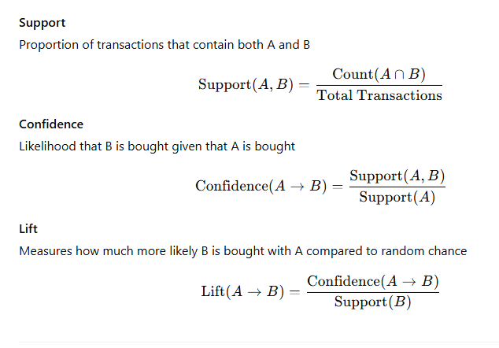
To evaluate the strength and relevance of rules, we use:

Slide 7
The Support Metric - "How Popular Is This Pattern?"
Definition
Percentage of transactions containing the itemset
Formula
Support(X) = Count(transactions with X) / Total transactions
Calculations from Our Data
Support({Bread}) = 6/10 = 60%
Support({Milk}) = 5/10 = 50%
Support({Butter}) = 5/10 = 50%
Support({Cheese}) = 6/10 = 60%
Support({Bread, Milk}) = 3/10 = 30%
Support({Butter, Cheese}) = 4/10 = 40%
Why Support Matters
High support: Common, reliable patterns
Low support: Rare, potentially spurious patterns
Threshold: Typically, 5-20% depending on business context
Transaction ID | Items Purchased
T1 | {Bread, Milk, Eggs}
T2 | {Bread, Butter, Cheese}
T3 | {Milk, Butter, Cheese, Yogurt}
T4 | {Bread, Milk, Butter}
T5 | {Bread, Milk, Eggs, Cheese}
T6 | {Butter, Cheese, Yogurt}
T7 | {Bread, Butter, Eggs}
T8 | {Milk, Cheese, Yogurt}
T9 | {Bread, Milk, Butter, Cheese}
T10 | {Eggs, Cheese, Yogurt}

Slide 8
The Confidence Metric – Direction Matters
Support tells us how many times two items appear together:
Support(milk ∩ diapers) = 100 / 1000 = 10%
But support is symmetric (have no direction) it does not tell us if we should recommend milk when diapers are bought or should we recommend milk when diapers are bought?
Confidence answers this question by measuring the conditional probability.
Scenario: We have 1,000 transactions of Itemsets: {Milk, Diapers}
Raw Data:
500 bought milk
150 bought diapers
100 bought both milk and diapers
Which rule should we use
Diapers → Milk
Milk -> Diapers
Or Both?

Slide 9
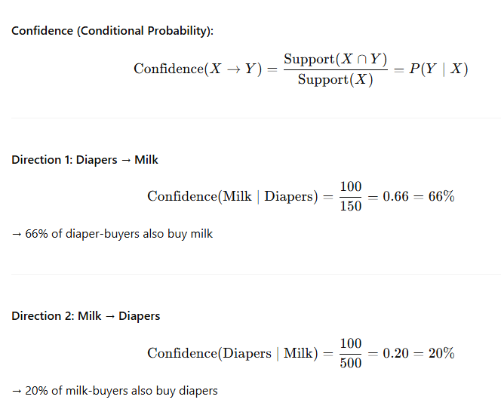
The Confidence Metric – Direction Matters
Therefore, Diapers → Milk is the rule that we should select

Slide 10
The Importance of Confidence, Direction Matters
Domain | Rule A → B (Strong) | Rule B → A (Weak or Misleading) | Reason for Asymmetry
Retail | Buys Smartphone → Buys Phone Case | Buys Phone Case → Buys Smartphone | Cases are often bought later or as replacements
Web Analytics | Visits Product Page → Adds to Cart | Adds to Cart → Visits Product Page | Visit is required, but not all visits lead to cart
Healthcare | Diagnosed with Diabetes → Prescribed Insulin | Prescribed Insulin → Diagnosed with Diabetes | Insulin used for other conditions too
Fraud Detection | Unusual Login → Account Lock | Account Lock → Unusual Login | Locks triggered by various issues
E-Learning | Watches Lecture Video → Submits Homework | Submits Homework → Watches Lecture Video | Some students skip the video
Streaming Services | Subscribes to Premium Plan → Watches Exclusive Shows | Watches Exclusive Shows → Subscribes to Premium Plan | Content may be shared or watched via someone else's account
Finance | Misses Loan Payment → Credit Score Drops | Credit Score Drops → Misses Loan Payment | Scores drop for many other financial behaviors
HR / Workforce | Attends Training → Improved Job Performance | Improved Job Performance → Attended Training | Performance may improve for unrelated reasons

Slide 11
The Lift Metric
The confidence metric can be misleading in some scenarios such as when the consequent is a common item.
The lift metric answers the questions whether this co-occurrence is truly meaningful or it occurred just by change.
Scenario: We analyze 100 transactions at a bakery.
Itemset: {Biscuits, Bread}
Observations:
40 people bought biscuits
100 people bought bread
32 of those who bought biscuits also bought bread
Confidence (Bread | Biscuits): = 32 / 40 = 80%
But Bread is Bought in Every Transaction: Support(Bread) = 100 / 100 = 1.0
We can use Lift to expose this relation
Lift = Confidence / Support(Bread): = 0.80 / 1.0 = 0.8 (below 1)
Interpretation:
Confidence is high (80%), suggesting a strong rule
But since bread is in every basket, the 80% is not surprising
Lift < 1 shows this is actually a weak or negative association
Conclusion:
Lift adjusts for how common the consequent is.
It reveals when a high confidence is simply a result of a popular item, not a meaningful relationship.

Slide 12
Possible Lift Values
Lift > 1: Items A and B are positively correlated (they appear together more than expected)
Lift < 1: Items A and B are negatively correlated (they appear together less than expected)
Lift = 1: Items A and B are independent (no association)

Slide 13
Lift Examples: Lift > 1
Example: Analyzing convenience store purchases.
Items: {Chips, Soda}
From 100 transactions:
40 people bought chips
50 people bought soda
30 people bought both chips and soda
Metrics:
Support (chips ∩ soda) = 30 / 100 = 0.30
Support (chips) = 40 / 100 = 0.40
Support (soda) = 50 / 100 = 0.50
Confidence (soda | chips):= 0.30 / 0.40 = 0.75
Lift:= 0.75 / 0.50 = 1.5
Interpretation:
A lift of 1.5 means that people who buy chips are 50% more likely to also buy soda than the average customer.
This shows a positive association, which makes sense: chips and soda are often consumed together.

Slide 14
Lift Examples: Lift < 1 – Negative Relationship
Lift can be less than 1 in two cases:
When the consequent is common like in the bread/butter example.
When there is a negative relationship between the antecedent and the consequent as show next.
Example: Analyzing supermarket transactions.
Items: {Toothpaste, Candy}
Data from 100 transactions:
40 people bought toothpaste
30 people bought candy
Only 4 people bought both toothpaste and candy
Metrics:
Support (toothpaste ∩ candy) = 4 / 100 = 0.04
Support (toothpaste) = 40 / 100 = 0.40
Support (candy) = 30 / 100 = 0.30
Confidence (candy | toothpaste):= Support (toothpaste ∩ candy) / Support (toothpaste)= 0.04 / 0.40 = 0.10
Lift:= Confidence / Support (candy)= 0.10 / 0.30 = 0.33
Interpretation:
A lift of 0.33 means people who buy toothpaste are less likely to buy candy than the average customer.
This negative association makes sense intuitively: people buying dental hygiene products might avoid sugary items like candy.

Slide 15
Lift Examples:- Lift = 1
Example: Analyzing grocery store data.
Items: {Milk, Bread}
From 100 transactions:
40 people bought milk
50 people bought bread
20 people bought both milk and bread
Metrics:
Support (milk ∩ bread) = 20 / 100 = 0.20
Support (milk) = 40 / 100 = 0.40
Support (bread) = 50 / 100 = 0.50
Confidence (bread | milk):= 0.20 / 0.40 = 0.50
Lift:= 0.50 / 0.50 = 1.0
Another Example: Analyzing grocery store data.
Items: {Milk, Bread}
From 100 transactions:
40 people bought milk
40 people bought bread
16 people bought both milk and bread
Metrics:
Support (milk ∩ bread) = 16 / 100 = 0.16
Support (milk) = 40 / 100 = 0.40
Support (bread) = 40 / 100 = 0.40
Confidence (bread | milk):= 0.16 / 0.40 = 0.40
Lift:= 0.40 / 0.40 = 1.0
Interpretation:
A lift of 1 means people who buy milk are neither more nor less likely to buy bread than the general population.
This suggests no real association between milk and bread in this dataset.

Slide 16
Apriori Algorithm Overview
Core Principle: Apriori Property
"All subsets of a frequent itemset must be frequent"
Example
If {Bread, Milk, Butter} is frequent, then:
{Bread, Milk} must be frequent
{Bread, Butter} must be frequent
{Milk, Butter} must be frequent
{Bread}, {Milk}, {Butter} must be frequent
Pruning Power
If {Bread, Milk} is NOT frequent, then:
{Bread, Milk, Butter} cannot be frequent
{Bread, Milk, Cheese} cannot be frequent
Any superset containing {Bread, Milk} can be eliminated

Slide 17
Apriori Algorithm Steps
Algorithm Workflow
Find L₁: Count all items, keep frequent ones
Generate candidates: Combine frequent (k-1)-itemsets
Prune candidates: Remove those with infrequent subsets
Count support: Scan database for remaining candidates
Filter: Keep only frequent k-itemsets
Repeat: Until no new frequent itemsets found
Generate rules: From all frequent itemsets
Parameters for Our Example
Minimum Support: 30% (3 out of 10 transactions)
Minimum Confidence: 60%
Minimum Lift: 1.2

Slide 18
Iteration 1 - Find Frequent Items
Count Individual Items
Item | Count | Support | Status
Bread | 6 | 60% | ✓
Milk | 5 | 50% | ✓
Butter | 5 | 50% | ✓
Cheese | 6 | 60% | ✓
Eggs | 4 | 40% | ✓
Yogurt | 3 | 30% | ✓
Result: L₁ (Frequent 1-itemsets)
All items meet 30% minimum support threshold
L₁ = {{Bread}, {Milk}, {Butter}, {Cheese}, {Eggs}, {Yogurt}}

Slide 19
Iteration 2 - Find Frequent Pairs
Generate All Possible Pairs
6 items → 15 possible pairs
Count Support for Each Pair
Itemset | Transactions | Count | Support | Status
{Bread, Milk} | T1,T4,T5,T9 | 4 | 40% | ✓
{Bread, Butter} | T2,T4,T7,T9 | 4 | 40% | ✓
{Bread, Cheese} | T2,T5,T9 | 3 | 30% | ✓
{Bread, Eggs} | T1,T5,T7 | 3 | 30% | ✓
{Bread, Yogurt} | None | 0 | 0% | ✗
{Milk, Butter} | T3,T4,T9 | 3 | 30% | ✓
{Milk, Cheese} | T3,T5,T8,T9 | 4 | 40% | ✓
{Milk, Eggs} | T1,T5 | 2 | 20% | ✗
{Milk, Yogurt} | T3,T8 | 2 | 20% | ✗
{Butter, Cheese} | T2,T3,T6,T9 | 4 | 40% | ✓
{Butter, Eggs} | T7 | 1 | 10% | ✗
{Butter, Yogurt} | T3,T6 | 2 | 20% | ✗
{Cheese, Eggs} | T5,T10 | 2 | 20% | ✗
{Cheese, Yogurt} | T3,T6,T8,T10 | 4 | 40% | ✓
{Eggs, Yogurt} | T10 | 1 | 10% | ✗

Slide 20
Iteration 2 Results
L₂ (Frequent 2-itemsets)
{Bread, Milk} - 40% support {Bread, Butter} - 40% support {Bread, Cheese} - 30% support {Bread, Eggs} - 30% support {Milk, Butter} - 30% support {Milk, Cheese} - 40% support {Butter, Cheese} - 40% support {Cheese, Yogurt} - 40% support
Key Observations
8 frequent pairs out of 15 possible
{Bread, Yogurt} has 0% support - strong negative correlation
{Butter, Cheese} has highest support (40%) - good combination

Slide 21
Iteration 3 - Generate 3-itemset Candidates
Step 1: Candidate Generation (Join Step)
Combine frequent 2-itemsets that share exactly one item:
{Bread, Milk} + {Bread, Butter} → candidate {Bread, Milk, Butter}
{Bread, Milk} + {Bread, Cheese} → candidate {Bread, Milk, Cheese}
{Bread, Butter} + {Bread, Cheese} → candidate {Bread, Butter, Cheese}
{Milk, Butter} + {Milk, Cheese} → candidate {Milk, Butter, Cheese}
Step 2: Prune Candidates (Based on Apriori Property)
For each candidate, check if ALL its 2-subsets are frequent:
{Bread, Milk, Butter}:
{Bread, Milk} ✓ (in L₂), {Bread, Butter} ✓ (in L₂), {Milk, Butter} ✓ (in L₂)
Keep candidate
{Bread, Milk, Cheese}:
{Bread, Milk} ✓ (in L₂), {Bread, Cheese} ✓ (in L₂), {Milk, Cheese} ✓ (in L₂)
Keep candidate
Step 3: Ready for Database Scan
4 candidates survive pruning - now we check which ones actually exist in transactions!

Slide 22
Iteration 3 - Count Actual Support in Database
Step 4: Database Scan (The Crucial Step!)
Now we check: Do these 3 items actually appear together in real transactions?
Candidate | Which Transactions? | Count | Support | Status
{Bread, Milk, Butter} | T4, T9 | 2 | 20% | ✗
{Bread, Milk, Cheese} | T5, T9 | 2 | 20% | ✗
{Bread, Butter, Cheese} | T2, T9 | 2 | 20% | ✗
{Milk, Butter, Cheese} | T3, T9 | 2 | 20% | ✗
Let's Verify One Example:
{Bread, Milk, Butter} appears in:
T4: {Bread, Milk, Butter} ✓
T9: {Bread, Milk, Butter, Cheese} ✓
Count: 2 transactions out of 10 = 20% support
Result: L₃ = {} (Empty Set)
No 3-itemsets meet our 30% minimum support threshold
Algorithm Terminates
Cannot generate any 4-itemsets since L₃ is empty

Slide 23
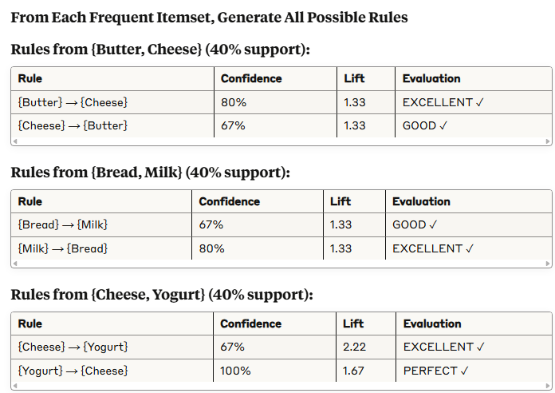
Generate Association Rules

Slide 24
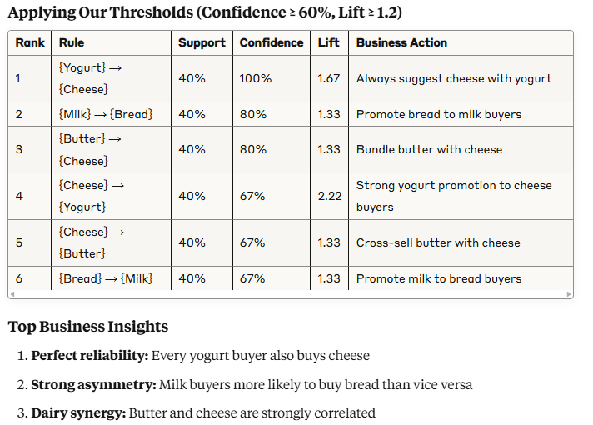
Final Rule Ranking

Slide 25
Why Each Metric Was Essential
Support Eliminated Rare Patterns
{Eggs, Yogurt}: Only 10% support → Too rare to be reliable
{Bread, Yogurt}: 0% support → Strong negative correlation discovered
Confidence Revealed Direction
{Butter} → {Cheese}: 80% confidence
{Cheese} → {Butter}: 67% confidence
Action: Prioritize cheese recommendations to butter buyers
Lift Identified True Correlations
{Cheese} → {Yogurt}: 67% confidence seems modest
But lift = 2.22: Cheese buyers are 122% more likely to buy yogurt!
Insight: This is actually a very strong relationship
Combined Power
Without all three metrics, we would miss the strongest business opportunities and waste resources on weak relationships

Slide 26
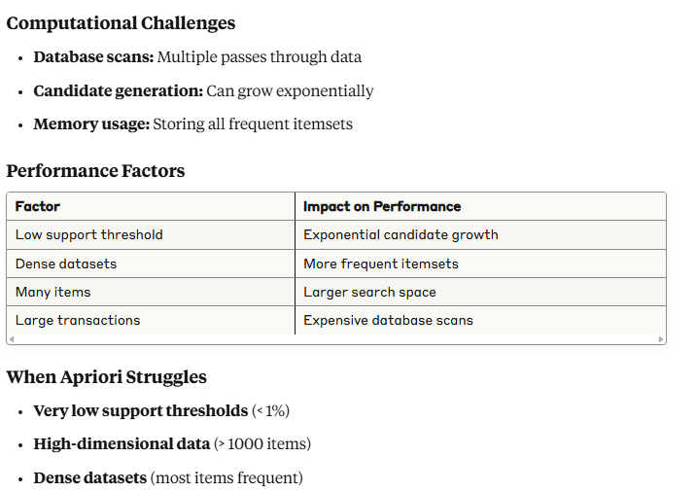
Computational Complexity and Limitations

Slide 27
Alternative Algorithms
FP-Growth
Advantage: Only 2 database scans
Method: Compact FP-tree data structure
Best for: Dense datasets, low support thresholds
ECLAT
Advantage: Vertical data representation
Method: Set intersection operations
Best for: Sparse datasets, many unique items
Modern Approaches
Parallel processing: Distributed Apriori implementations
Approximate algorithms: Trade accuracy for speed
Streaming algorithms: Handle continuous data flows

Slide 28
Practical Business Applications
Supermarket Chain Strategy
Discovered Rules:
{Yogurt} → {Cheese} (100% confidence, 1.67 lift)
{Butter} → {Cheese} (80% confidence, 1.33 lift)
Business Actions:
Place cheese display near yogurt section
Create butter-cheese bundle promotions
Stock cheese heavily when yogurt sales increase
E-commerce Recommendations
Discovered Rules:
{Milk} → {Bread} (80% confidence, 1.33 lift)
Implementation:
"Customers who bought milk also bought bread"
Automatic cross-sell suggestions
Email marketing campaigns
Inventory Management
Negative Correlations:
{Bread, Yogurt} (0% support)
Insight: Customers segment into different dietary preferences Action: Separate promotional campaigns for different customer segments

Slide 29
Summary & Key Takeaways
What We Learned
Support filters rare, unreliable patterns
Confidence reveals directional strength and asymmetry
Lift distinguishes real correlation from coincidence
All three metrics together prevent false insights
Algorithm Insights
Apriori property enables efficient search space pruning
Multiple database scans are the main performance bottleneck
Parameter tuning dramatically affects both performance and results
Business Value
Actionable insights for cross-selling and recommendations
Customer behavior understanding beyond simple popularity
Data-driven decisions for product placement and marketing
Critical Success Factors
Domain expertise to interpret and validate rules
Proper preprocessing to clean and prepare data
Continuous monitoring to ensure rules remain relevant

Slide 30
Next Steps & Advanced Topics
Immediate Applications
Implement basic Apriori on your own datasets
Experiment with thresholds to understand trade-offs
Validate discovered rules with domain experts
Advanced Techniques
Sequential pattern mining: Time-ordered associations
Multi-level associations: Category hierarchies
Constraint-based mining: User-specified business rules
Modern Developments
Real-time association mining for streaming data
Privacy-preserving techniques for sensitive data
Deep learning approaches for complex pattern discovery
Tools to Explore
Python: mlxtend, apyori libraries
R: arules, arulesViz packages
Spark: MLlib for large-scale mining

